Slide 1



Employee Attrition report + analysis
View in Power BI
Last data refresh:
24/02/2023 13:09:24 UTC
Downloaded at:
24/02/2023 13:10:08 UTC

Slide 2
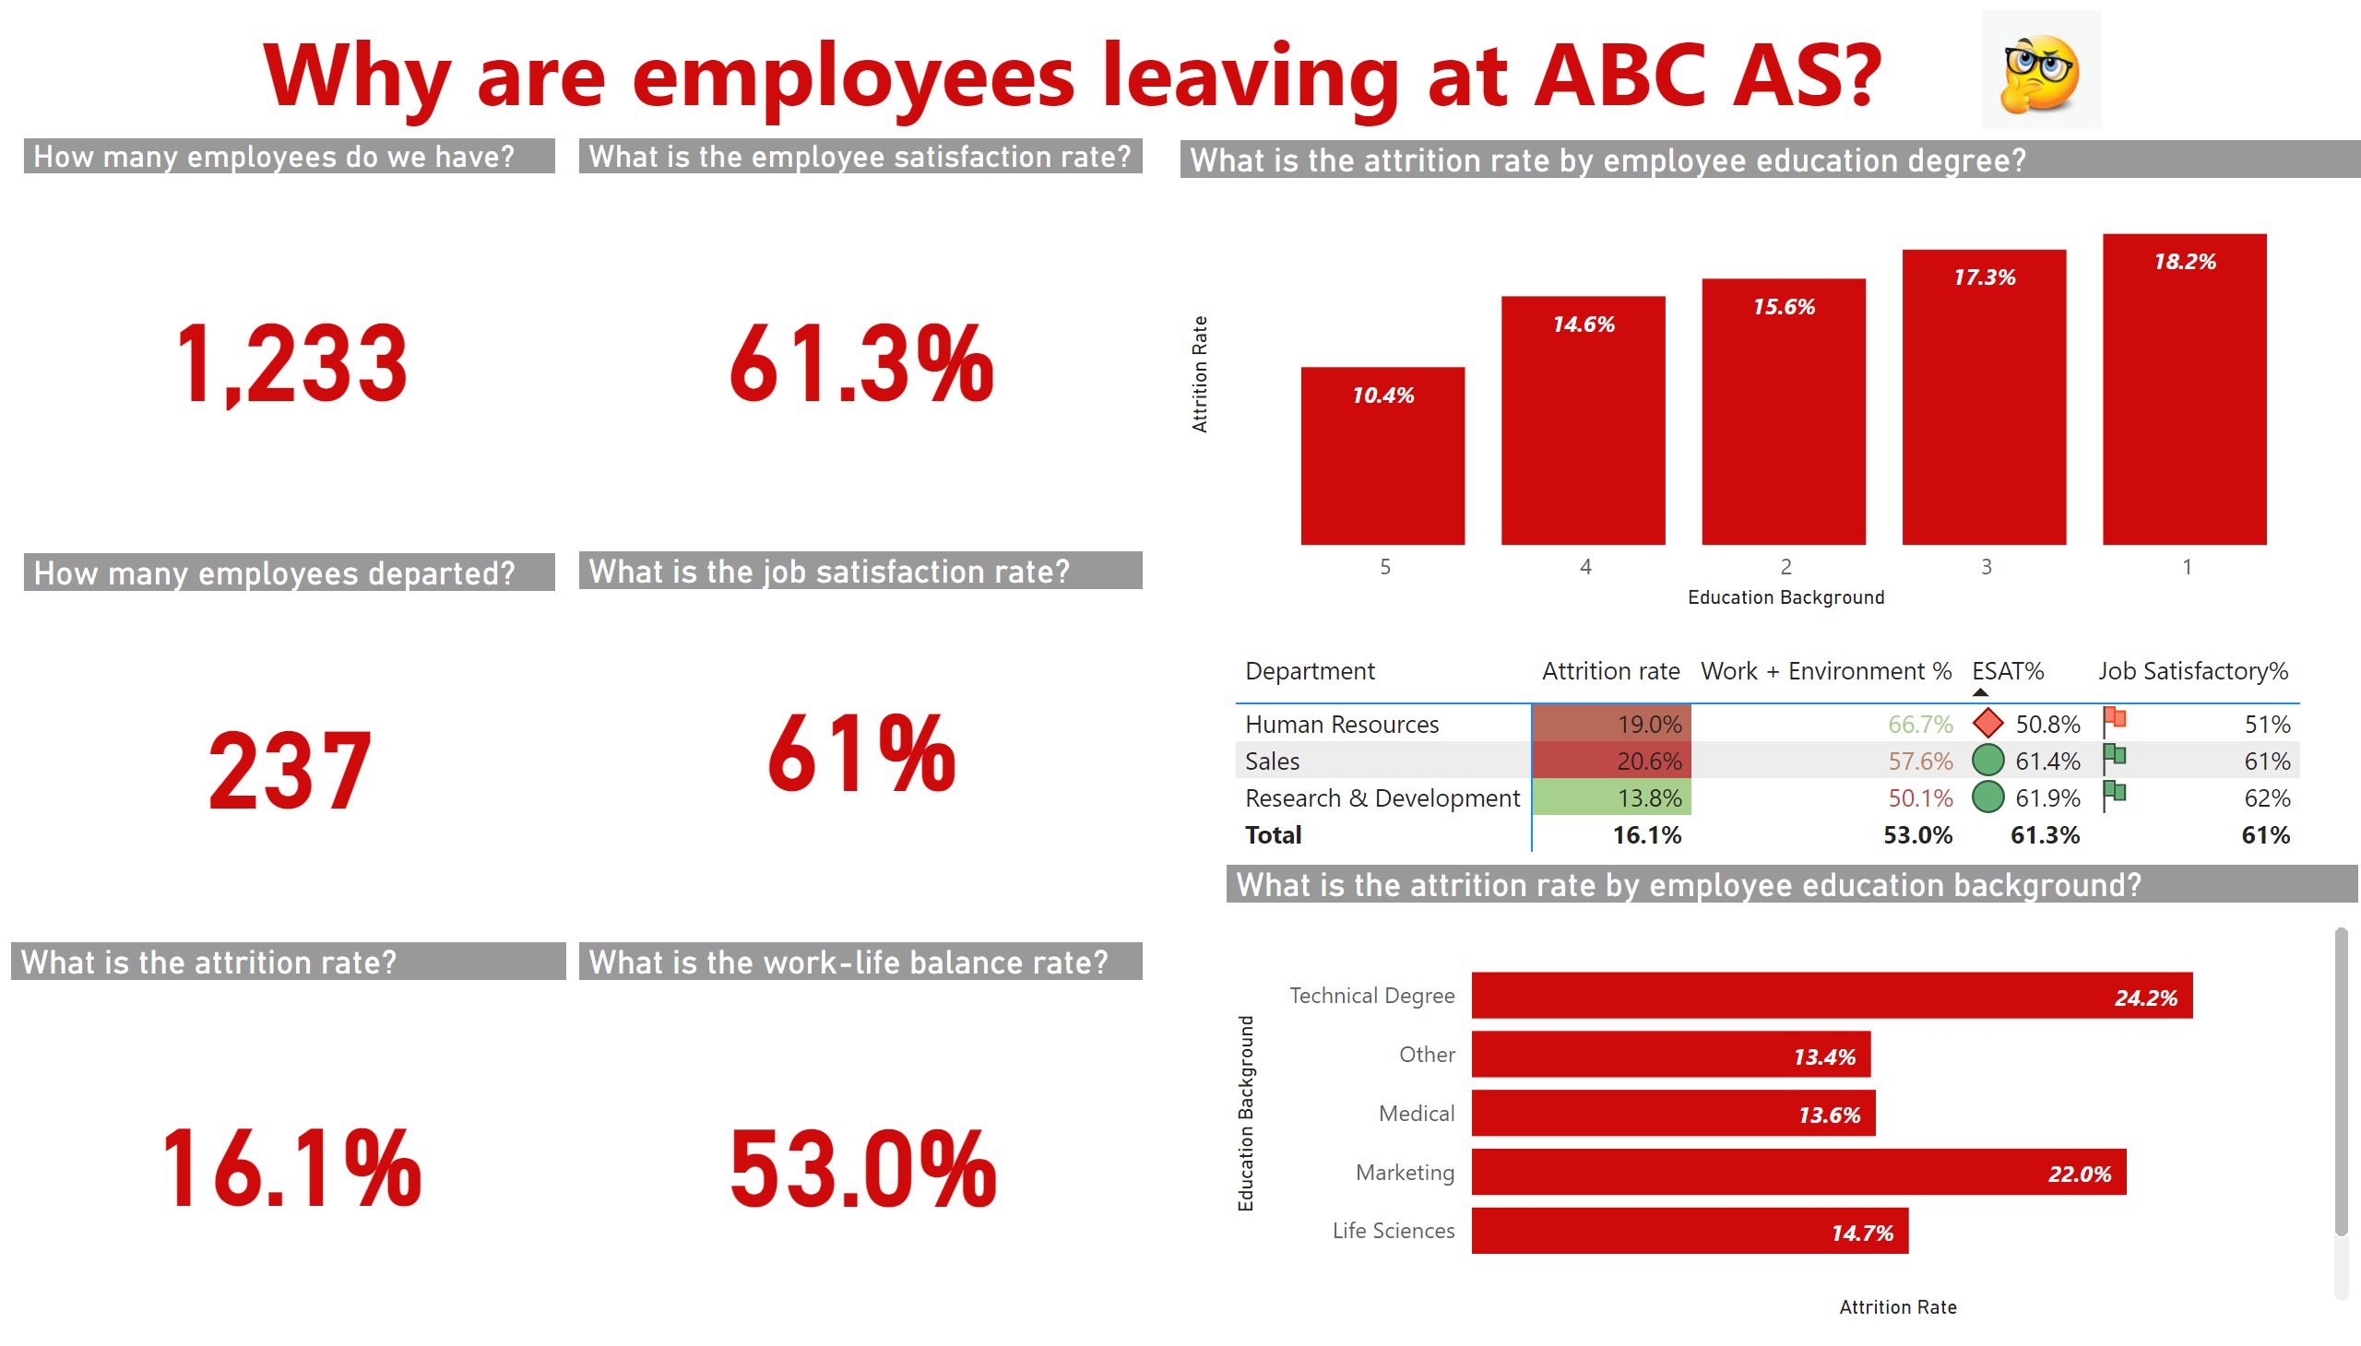
KPI report
Notes:
textbox
No alt text provided
How many employees do we have?
No alt text provided
How many employees departed?
No alt text provided
What is the employee satisfaction rate?
No alt text provided
What is the job satisfaction rate?
No alt text provided
pivotTable
No alt text provided
What is the attrition rate by employee education degree?
No alt text provided
What is the attrition rate by employee education background?
No alt text provided
What is the work-life balance rate?
No alt text provided
What is the attrition rate?
No alt text provided
image
No alt text provided

Slide 3
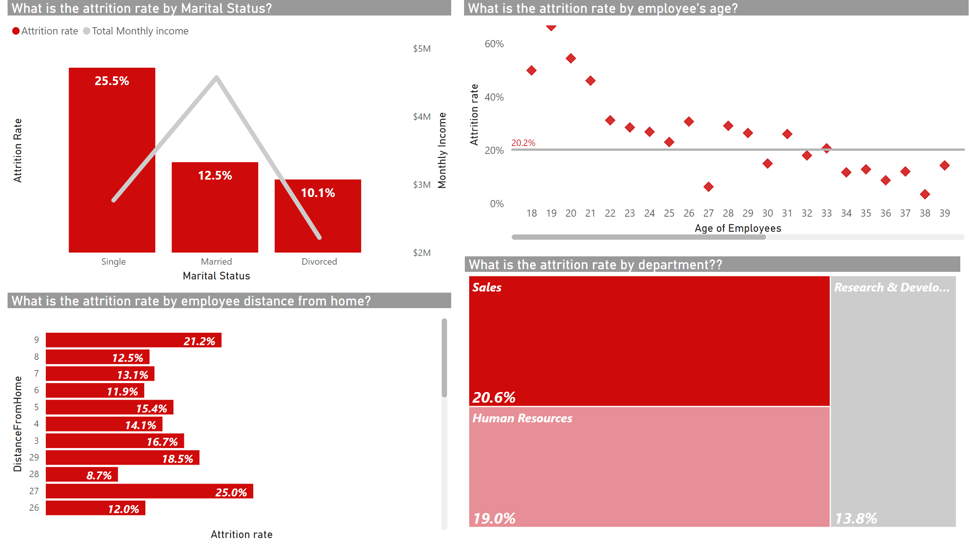
Detailed Report
Notes:
What is the attrition rate by Marital Status?
No alt text provided
What is the attrition rate by employee distance from home?
No alt text provided
What is the attrition rate by employee's age?
No alt text provided
What is the attrition rate by department??
No alt text provided

